Slide 1
Point 2
Point 1
Point 3

Slide 2











$$a_{3}$$
$$θ_{3}$$
$$γ$$
$$a_{2}$$
$$a_{2}$$
$$θ_{2}$$
$$l$$
$$l$$
$$γ$$
$$a_{1}$$
$$a_{1}$$

Slide 3
Elbow up
Joint 4
Zero config
Elbow down
Joint 3
Joint 4
End effector
Joint 3
Joint 2
Joint 3
Joint 4

Slide 4
Elbow up
Joint 4
Zero config
Elbow down
X
Joint 3
Joint 4
End effector
X
Z
Joint 3
Z
Impossible orientation
Joint 2

Slide 5

Drawing not to scale
187.325 mm
34 mm
34 mm
$$x_{2}$$
$$z_{2}$$
$$θ_{3}$$
$$z_{3}$$
Elbow
$$y_{3}$$
Wrist
$$x_{4}$$
$$x_{3}$$
$$x_{e}$$
$$θ_{4}$$
Gripper
$$y_{2}$$
$$z_{4}$$
$$θ_{5}$$
146.05 mm
$$y_{4}$$
$$z_{e}$$
$$y_{1}$$
$$z_{1}$$
Rotating wrist
$$θ_{2}$$
$$y_{e}$$
Shoulder
$$x_{1}$$
76.2 mm
$$z_{0}$$
$$y_{0}$$
$$θ_{1}$$
$$x_{0}$$
Base

Slide 6
Base
Obstacles

Slide 7
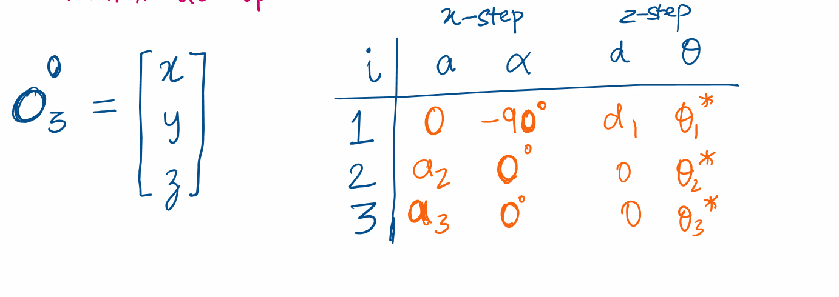
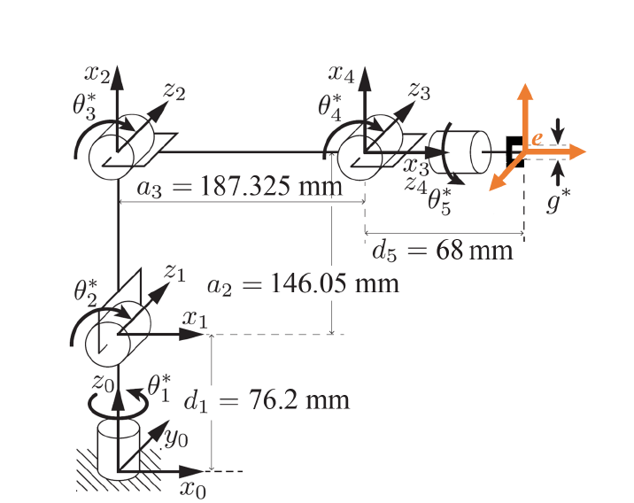
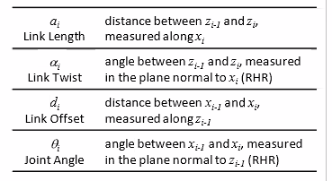
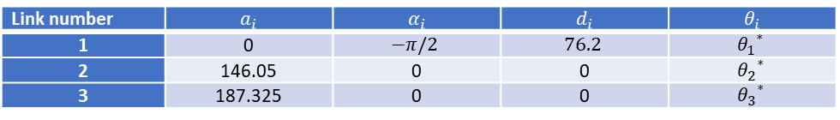
Link number | $$a_{i}$$ | $$α_{i}$$ | $$d_{i}$$ | $$θ_{i}$$
1 | 0 | $$−π/2$$ | $$76.2$$ | $${θ_{1}}^{∗}$$
2 | 146.05 | 0 | 0 | $${θ_{2}}^{∗}$$
3 | 187.325 | 0 | 0 | $${θ_{3}}^{∗}$$

Slide 8
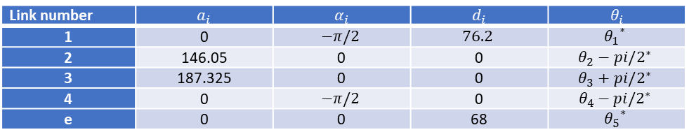
Link number | $$a_{i}$$ | $$α_{i}$$ | $$d_{i}$$ | $$θ_{i}$$
1 | 0 | $$−π/2$$ | $$76.2$$ | $${θ_{1}}^{∗}$$
2 | 146.05 | 0 | 0 | $${θ_{2}−pi/2}^{∗}$$
3 | 187.325 | 0 | 0 | $${θ_{3}+pi/2}^{∗}$$
4 | 0 | $$−π/2$$ | 0 | $${θ_{4}−pi/2}^{∗}$$
e | 0 | 0 | 68 | $${θ_{5}}^{∗}$$

Slide 9







$$Z_{des}$$
$$Z_{feas}$$
$$Y_{0}$$
End effector
$$Y_{des}$$
$$Y_{feas}$$
Wrist position
$$θ_{1}$$
$$X_{0}$$

Slide 10
Point 2
Point 1
Point 3
Joint 3
Joint 2

Slide 11
Joint 3
Wrist
Joint 2
Joint 3

Slide 12

$$Z_{des}$$
$$Z_{feas}$$
$$Y_{0}$$
End effector
$$n$$
$$X_{0}$$

Slide 13
Obstacle
Inflated Obstacle
Collision occurs
Collision occurs
Link
Link

Slide 14


$$Y_{0}$$
$$z$$
$$θ$$
$$X_{0}$$

